Slide 1

Emergency Preparedness for Hastings City Council

Slide 2
Overview and Introduction
We will review:
  What is NIMS and COOP?
  Continuity of Operations/Critical Elements
  Emergency Operations Plan
  City of Hastings Organizational Chart
  Levels of Emergencies
  Declaring Emergencies
  Communications
  City Council Expectations

Slide 3
What is NIMS?
National Incident Management System
  A standardized, flexible organizational management and planning system for events and incidents
  Common Terminology
  Allows all responders to organize under a single system
  Essential for natural and man-made disasters for efficient resolutions
  Five components of NIMS:
    Command and Management
    Preparedness
    Resource Management
    Communications
    Ongoing Management

Slide 4
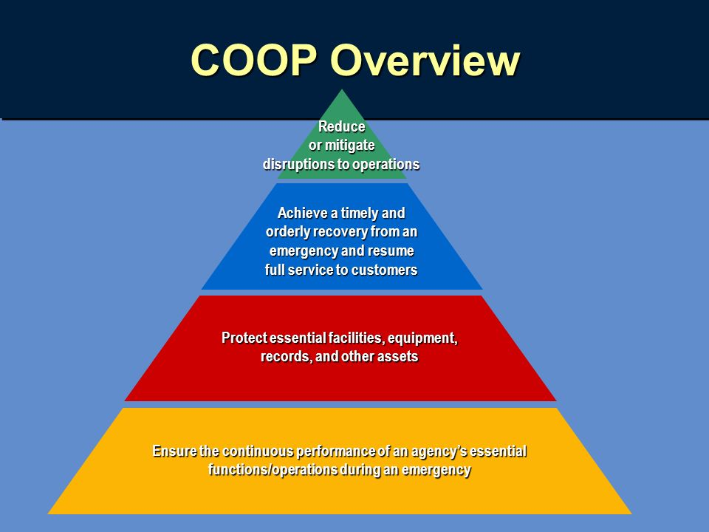
Continuity of Operations (COOP)
EM Handbook
Page 27 of handbook
The COOP ensures that essential functions continue during an emergency
Examples:
  Facilities
  Communications
  Records Management

Slide 5

Emergency Operations Plan (EOP)
When EOC (Emergency Operation Center) is activated
  Activation by:
    IC (Incident Commander)
    EM (Emergency Manager)
    Mayor
  Hastings Fire Station (Primary)
EOP resource for:
  Incident action
  Communication
  Mitigation
  Recovery

Slide 6
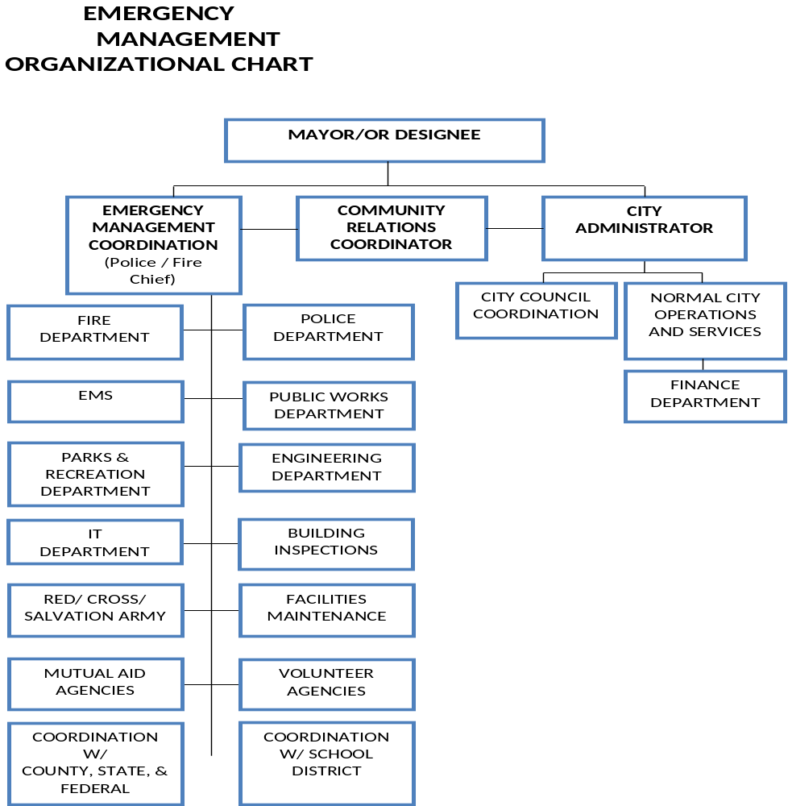

Slide 7
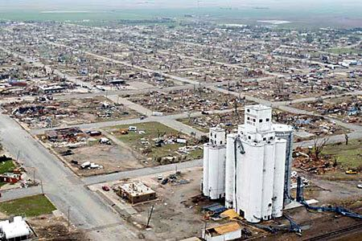
Measuring Risks
Level 1
Most complex, requiring national resources for the operation
All staff position filled and on site
Personnel can exceed 500
High impact on local jurisdiction

Slide 8

Measuring Risks
Level 2
Incident extends beyond the capabilities for local control
May include regional or national resources to assist
Operations personnel normally do not exceed 200

Slide 9
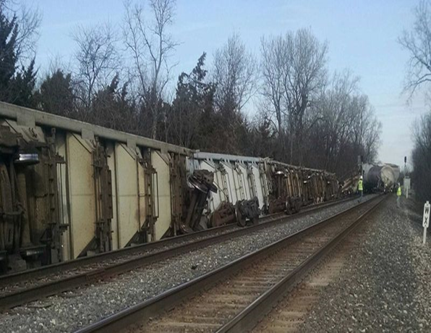
Measuring Risks
Level 3
Mutual aid generally not required
Staff positions may be activated, but most likely not all staff required
Level subject to change depending on incident dynamics

Slide 10
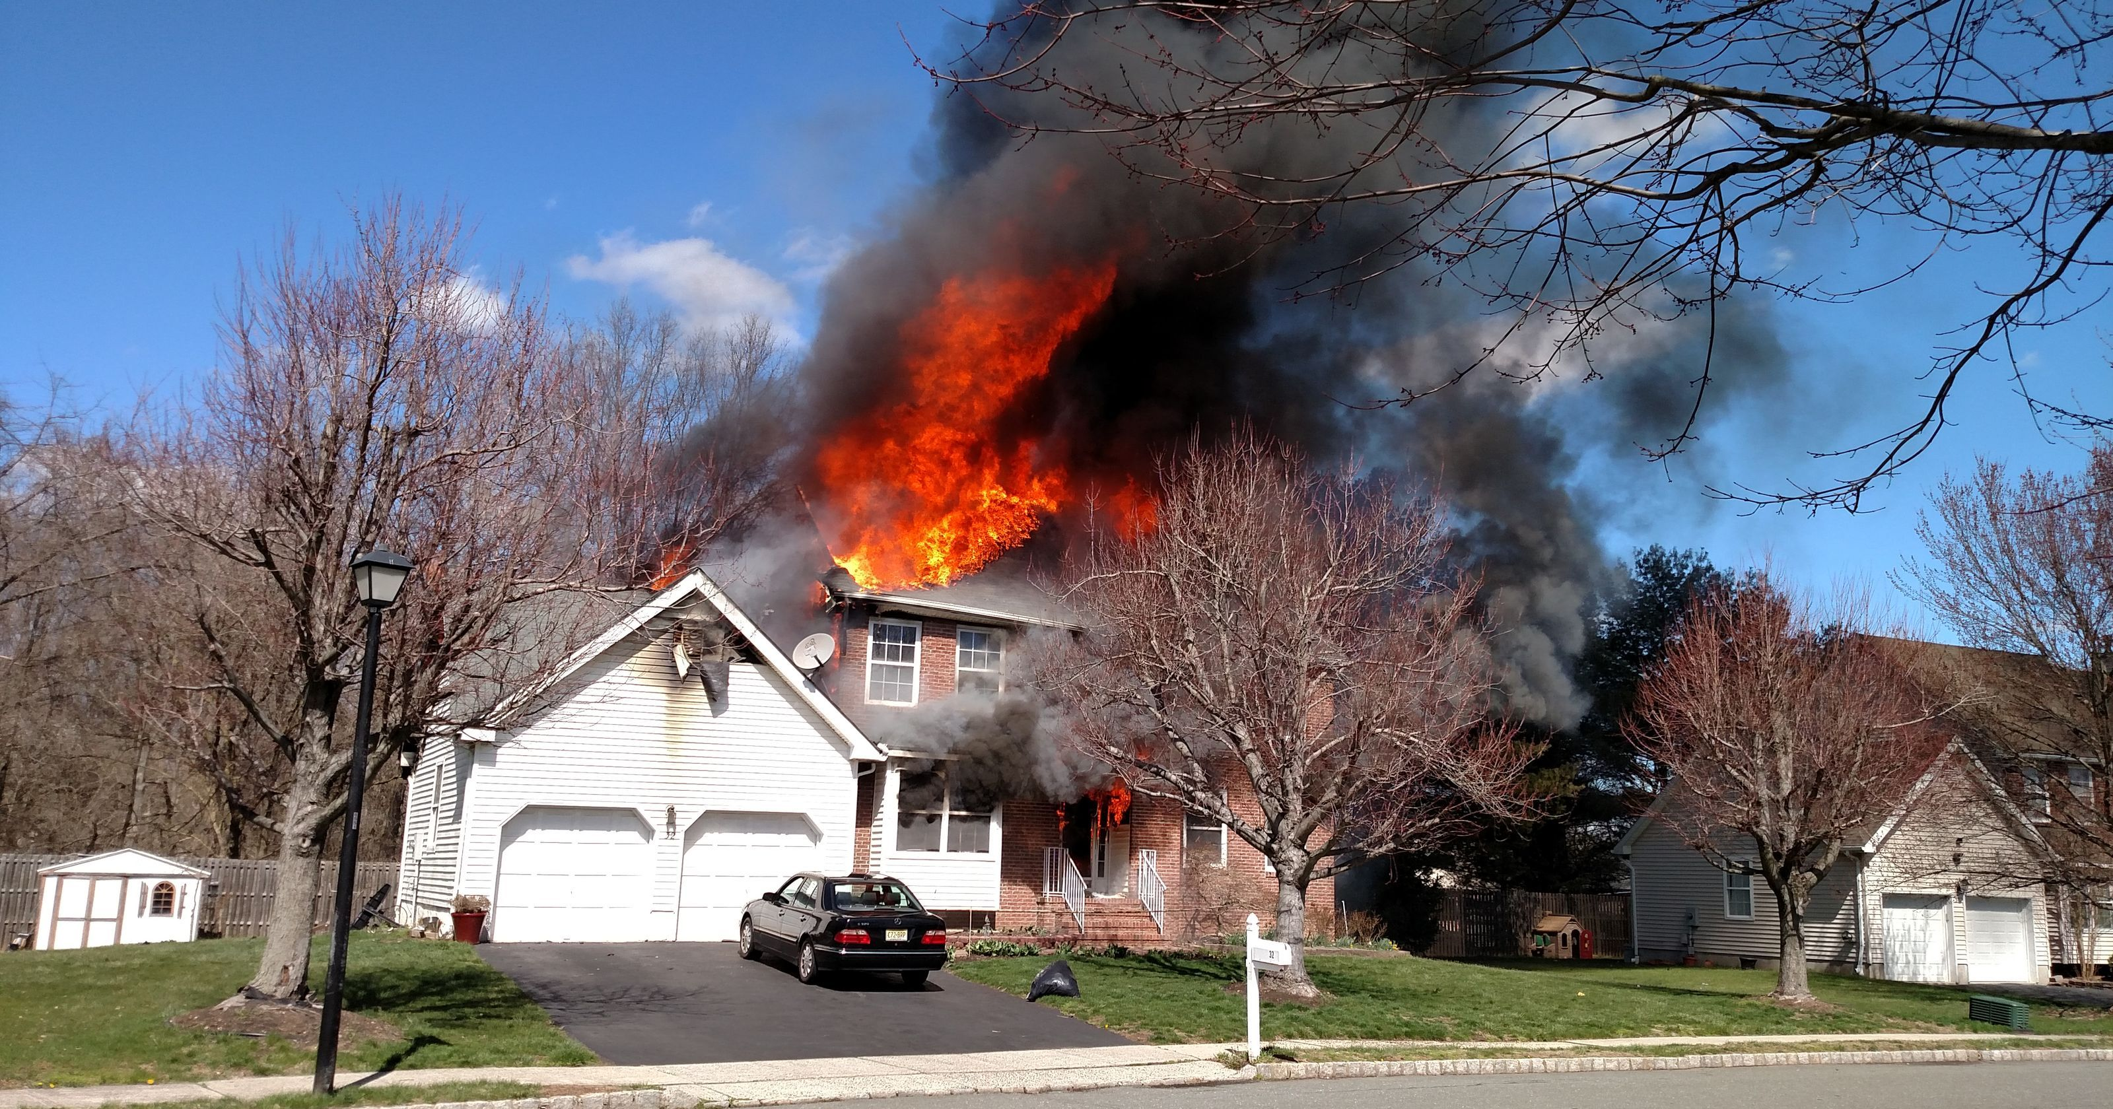
Measuring Risks
Level 4
Handled within jurisdiction by home agency
Incident usually requires one operational period
Generally does not require majority of resources for jurisdiction

Slide 11
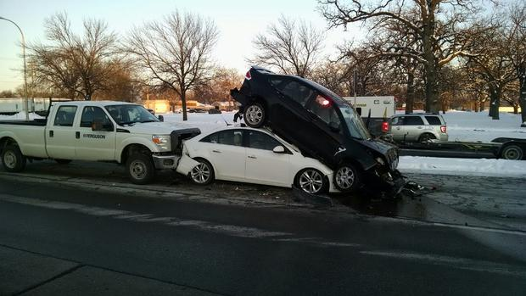
Measuring Risks
Level 5
Generally handled with minimal resources, up to six personnel
Command generally not activated
Contained within a short amount of time

Slide 12
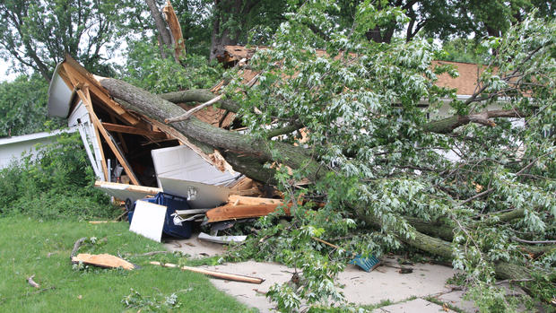

Emergency Declarations
Who can declare an emergency?
  Localized emergencies are declared by the Mayor
  Large scale emergencies (local resources inadequate to handle) are declared by the Governor
  Last emergency declaration for the City of Hastings was in the summer of 2012
    Chief Schutt – brief summary of 2012 declaration

Slide 13

Communications
City Council Members will be briefed by City Administrator in the event of a large scale incident
City Administrator will also provide guidance on requests to respond
Be prepared for failure of cell phones for large scale events
Plan ahead for potential communication issues

Slide 14
Expectations for City Council
Always be prepared
  Do Not Self Deploy; wait for notification from City Administrator that response is necessary
  Have ‘go bag’ ready if request comes in to respond
  Notify family and be reachable if requested to respond
  Have medications and toiletries/clothes for extended stay
  Have copy of EOP (Emergency Operation Plan) available
  If requested to respond, think ‘big picture’
    Recovery measures for city
    Plan for memorials (if incident dictates)
    Designate spokesperson from group

Slide 15

Questions?

