Slide 1

Preliminary 2021 Budget Discussion
May 18, 2020

Slide 2

Overview
Budget Preparation Schedule
Current Economic Situation
Major Revenues
Major Expenditures
Goals and Priorities
Council Direction

Slide 3
2021 Budget Preparation Schedule
May 18 – City Council Workshop
June 1 – Instructions to Departments
June 30 – Department Requests to City Administrator
July – Internal Department Budget Meetings
July 31 – City Administrator’s Budget Proposal
August – Finance Committee Budget Meetings
Sept 8 – City Council Sets Preliminary Tax Levy
Dec 7 – Truth In Taxation Hearing
Dec 21 – City Council Adopts Budget and Certifies Tax Levy

Slide 4
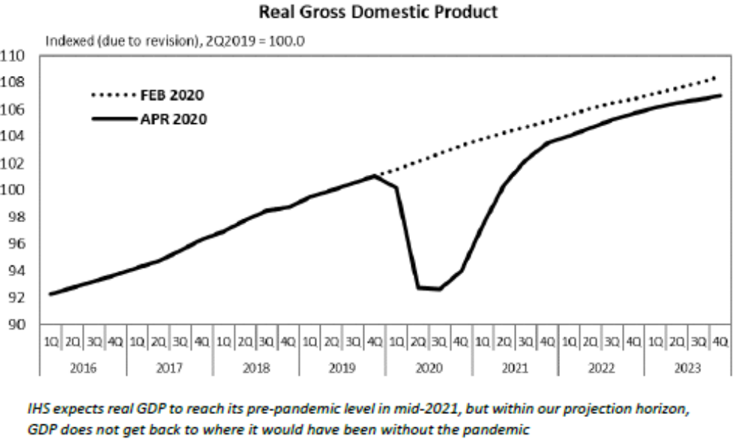
Current Economic Situation
State Budget – State went from $1.5B surplus to $2.4B deficit (5/5/20)
Unemployment Filings – 36.5M claims (5/4/20)
Uncertain shape and timing of recovery

Slide 5
Major Revenues
2020 Tax Rate 57.391% (levy $14,788,179)
Tax Capacity - $1,079,298 increase (4.76%)
LGA – identify one-time projects so less susceptible to cut in LGA
Tax Delinquency - experience during and following Great Recession (2007-2011)
  5.3% to 8.4% delinquent each year
  Would equal to $784K to $1.24M based on 2020 taxes

Slide 6
Major Expenditures: Personnel
Personnel Costs - $13.9M
COLA (each 1% on Jan 1st) - $105K
Health (estimate 10% increase) - $138K

Slide 7
Major Expenditures: CIP
Projects delayed in 2020…
  Vermillion Corridor Project
  HEDRA, other
  Vets Field Improvements
  2020 Mill & Overlay Program
Projects planned in 2021…
  Pool House & Mechanicals
  Lake Isabel Park
  City Hall / Police Remodel
  2021 Neighborhood Project
  2021 Mill & Overlay Program
  Sanitary Sewer Lining

Slide 8
Major Expenditures: CEP
Projects delayed in 2020…
  Fire Department study
  Facilities study
  Slide step replacement
  New Zamboni
  Public Works LED lighting
  Accounting software upgrade
  Police and Fire radios ERF
  Network switches
  Trail sealcoating
  Trail reconstruction
Projects planned in 2021…
  City Hall / Police boilers & HVAC
  Accounting software upgrade
  Fire Engine 1 replacement
  Fire equipment
  IT storage, computers, network
  Parks vehicles, mower, trail rehab
  Police radios
  Police squads
  Streetsweeper
  Dump truck
  Water meter replacement

Slide 9
Goals & Priorities
Communication – Optimal Service – Respect for Resources – Enthusiasm
Common Themes from Before
  Economic Development (eg: HEDRA, Vermillion Street)
  Transportation (eg: pavement management program)
  Housing (eg: new residential development)
  Community Image (eg: tourism, maintain park assets)
  Lifestyle & Recreation (eg: comprehensive parks plan)

Slide 10
Council Direction
Communication – Optimal Service – Respect for Resources – Enthusiasm
Framework Going Forward
  Maintaining Existing Assets (eg: roads, trails, buildings)
  Fiscally Sustainable (eg: CIP/CEP, reduce ongoing costs, long-term perspective)
  Uniquely Hastings (eg: parks & trails, downtown, Vermillion Street, City Hall)
Baseline Property Tax Rate / Levy – status quo

